Slide 1










Project Manager scenario with Point.io web console
Julien Gaye
Sales Engineer
+44 7708 147 445
jgaye@point.io

Slide 2
Project Manager scenario
The Project Manager selects the documents, users and users rights for the project he is creating. His goal is to grant the right accesses to the right persons for its project, while minimizing the enterprise storage exposure.
Access Rules and everything related to Hubs are managed by the Project Manager. In the web console, a hub represents a project.
The next slide shows the required components for a user interface
Green components are available in the current web console
Yellow components exist but are not displayed in the current console
Red components don’t exist yet

Slide 3
View Storage Sites
Delete
Storage Sites list
View My Hubs
Hubs list
Open
User list
Remove user
Add User
Create Hub
Shares list
Browse Share
Rights follow the Access Rules’ permissions
Add Share
Monitor activity
Activities list
Request Storage Site to the Storage Manager
Hub Information
Remove Share
View My Files
New Access Rule
Access Rule Information
Share Information
Access Rules list
Browse
Remove
Rights follow the Access Rules’ permissions
No Storage Site management

Slide 4
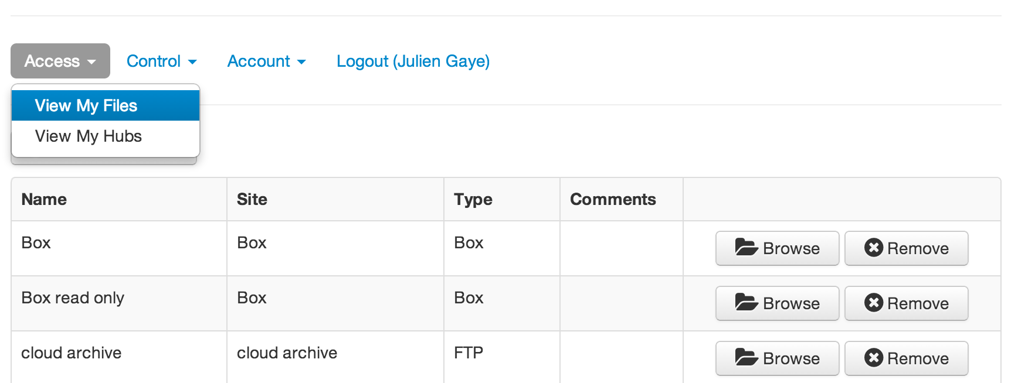
View my files
Notes:
The Storage Admin

Slide 5
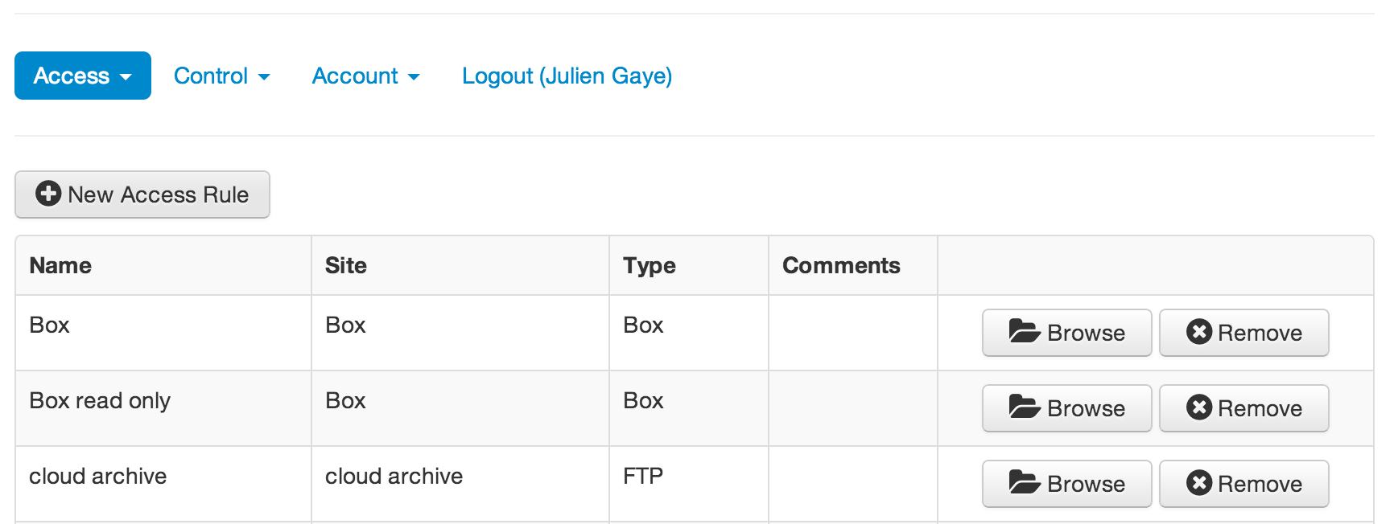
New Access rules
Notes:
The Storage Admin

Slide 6
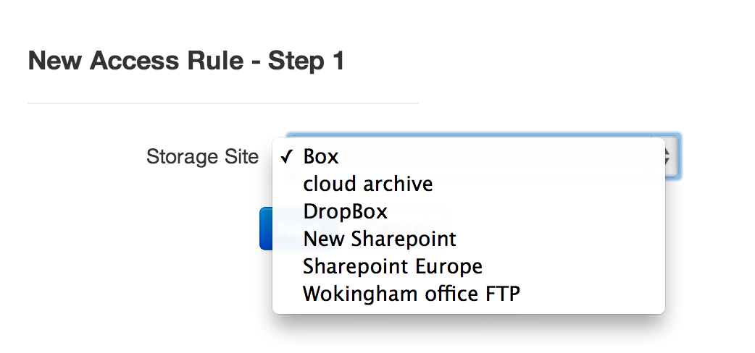
Access rule info part 1
Notes:
The Storage Admin

Slide 7
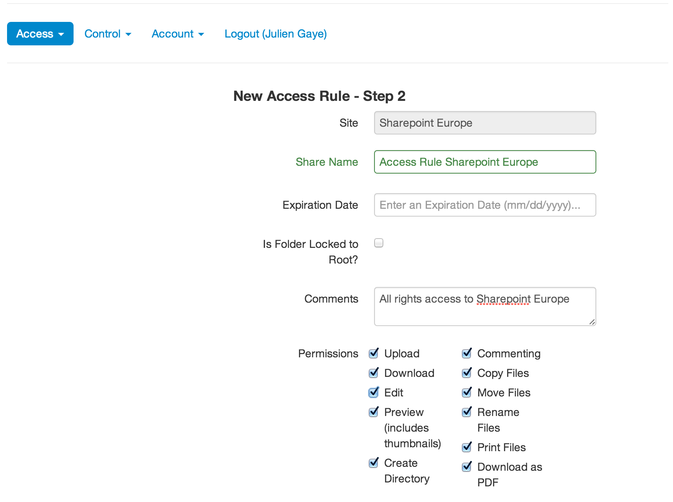
Access rules info part 2
Notes:
The Storage Admin

Slide 8
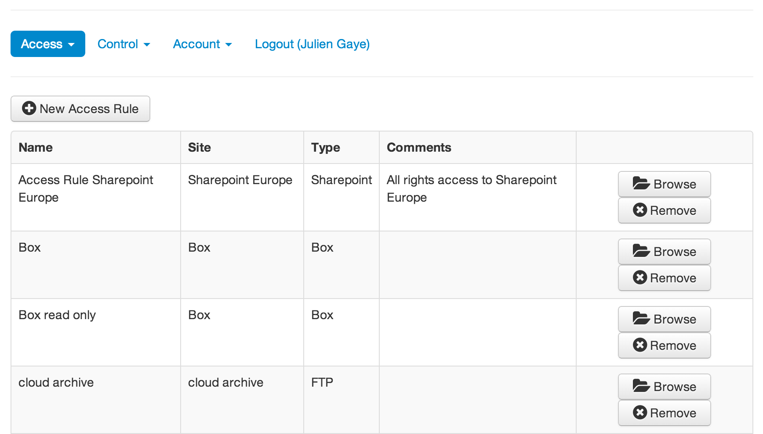
Access rules created
Notes:
The Storage Admin

Slide 9
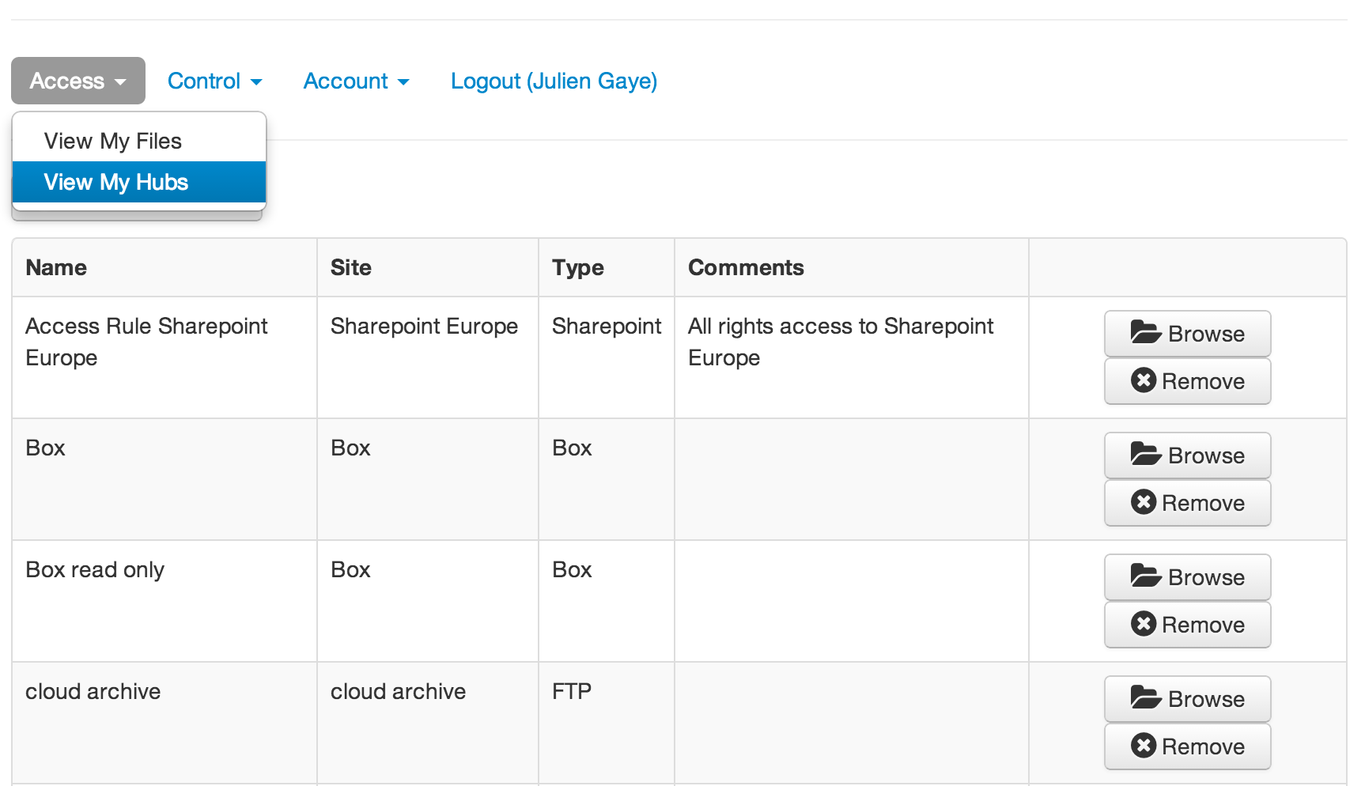
View my hubs
Notes:
The Storage Admin

Slide 10
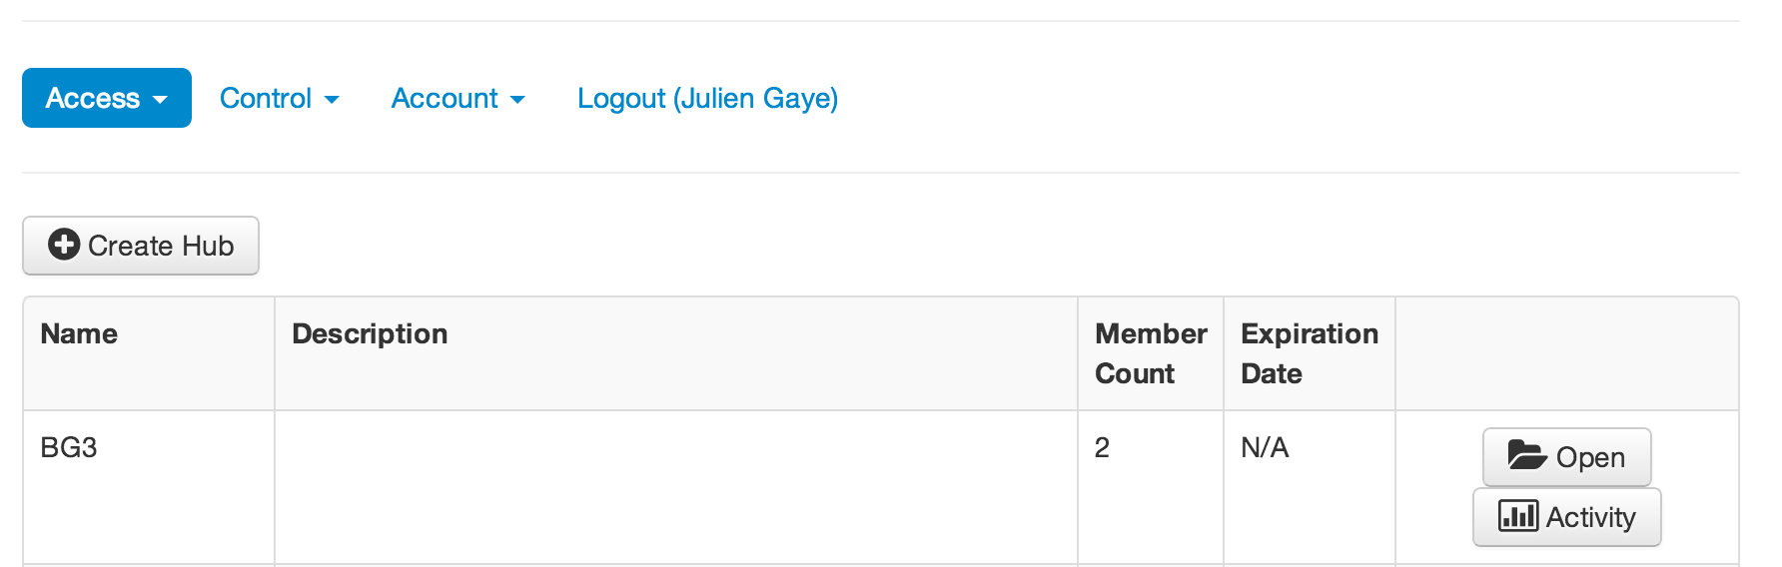
hubs
Notes:
The Storage Admin

Slide 11
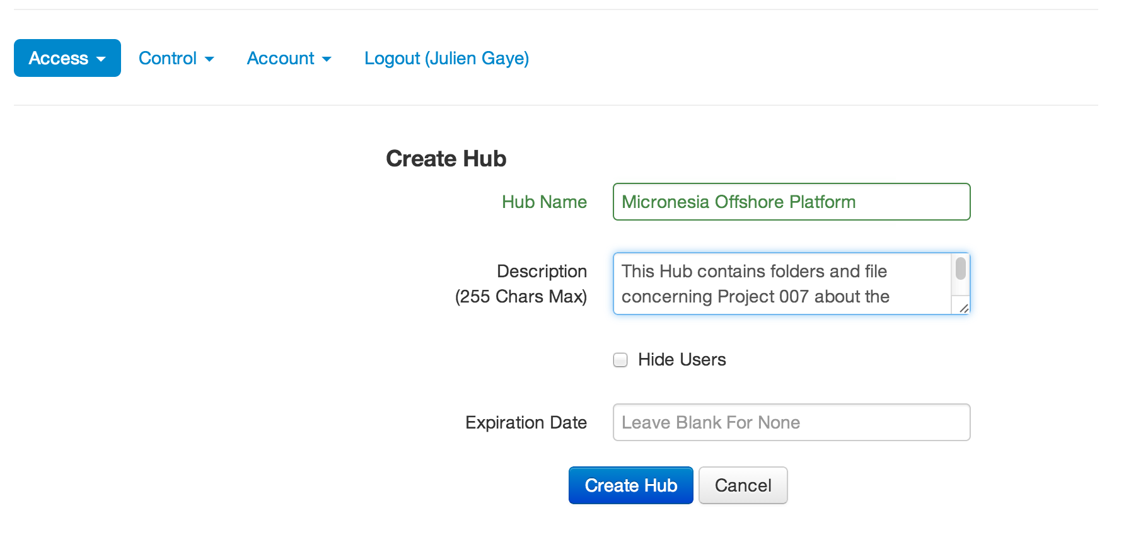
Hub infos
Notes:
The Storage Admin

Slide 12
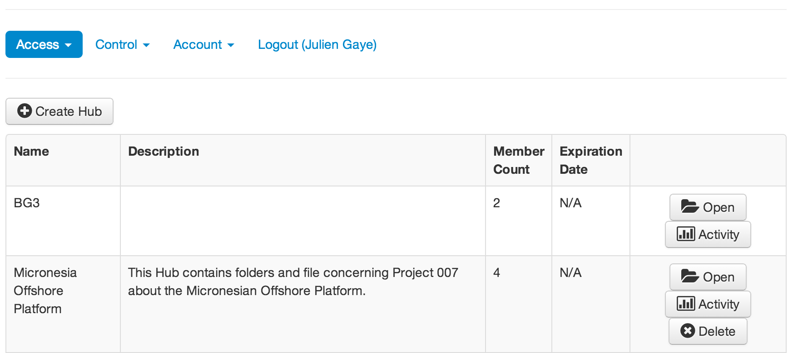
Hub created
Notes:
The Storage Admin

Slide 13
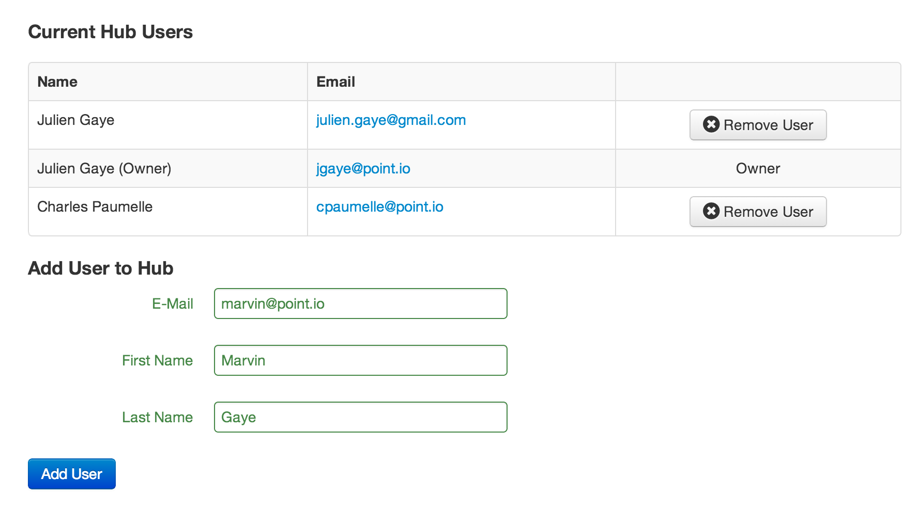
Add user
Notes:
The Storage Admin

Slide 14
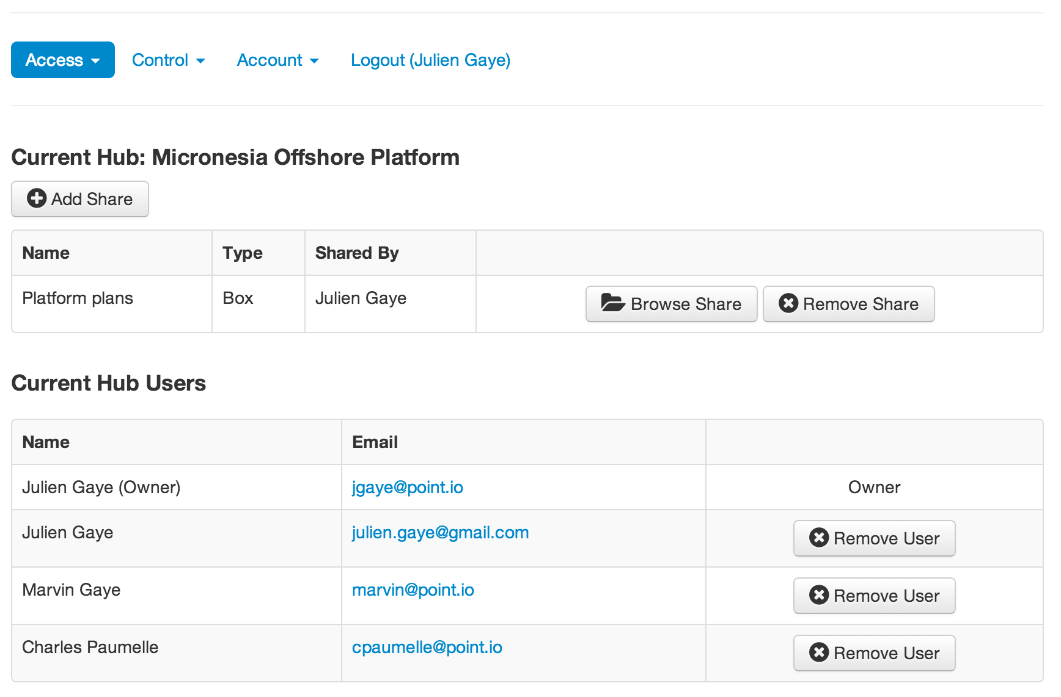
Shares and users
Notes:
The Storage Admin

Slide 15
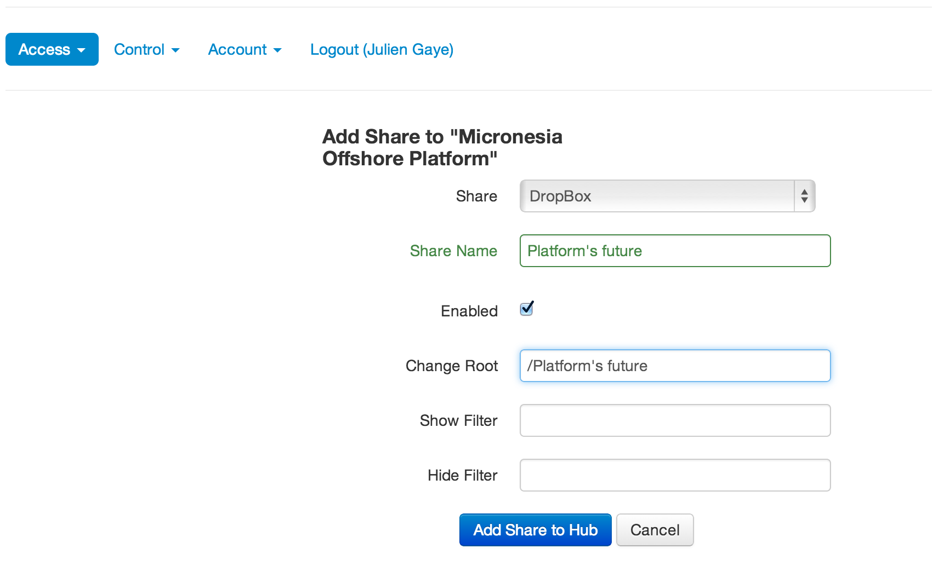
New share info
Notes:
The Storage Admin

Slide 16
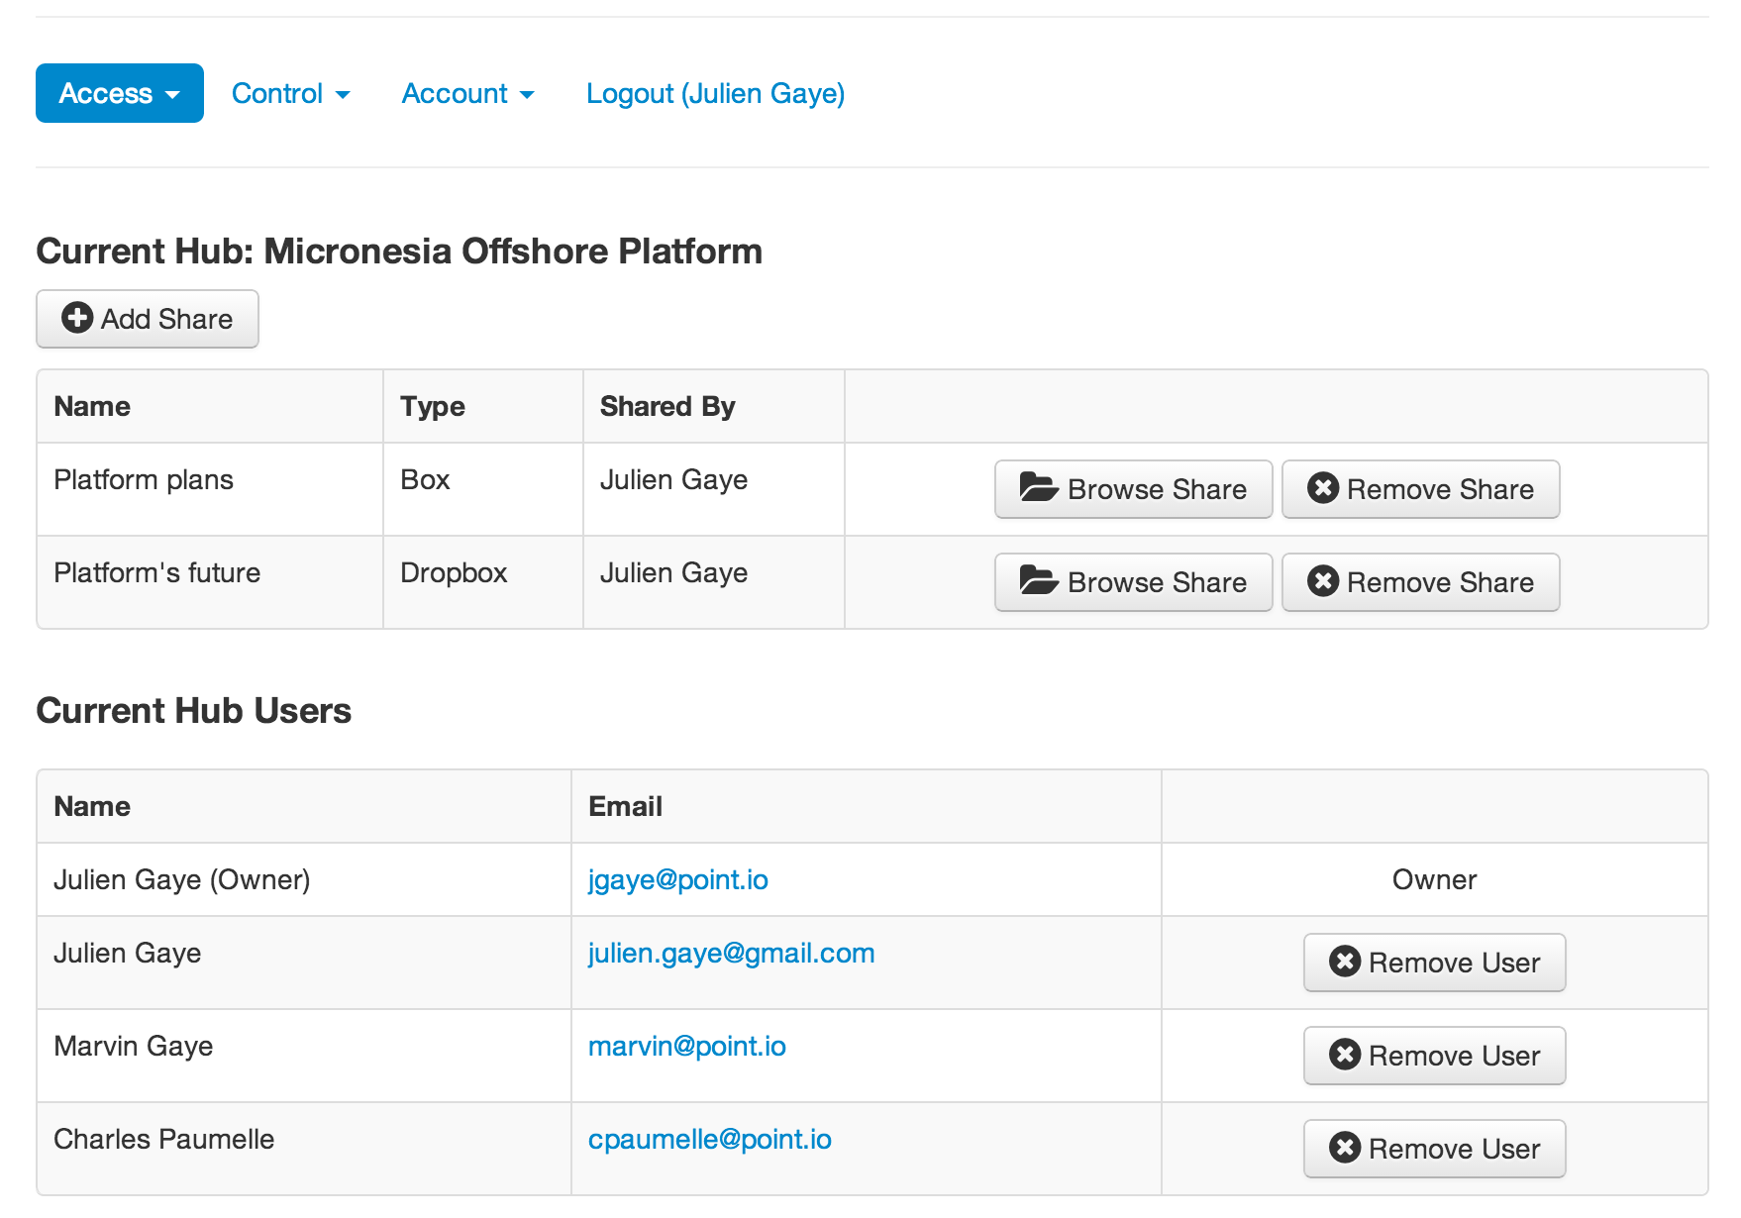
Share created
Notes:
The Storage Admin

Slide 17
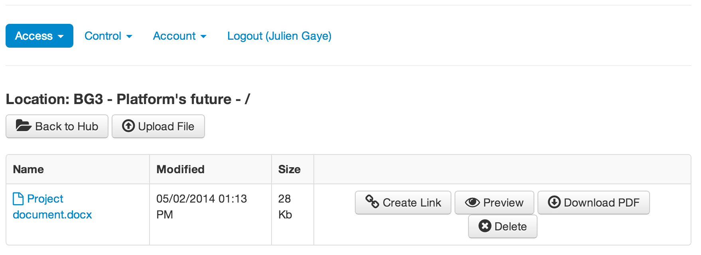
Browse share
Notes:
The Storage Admin

Slide 18
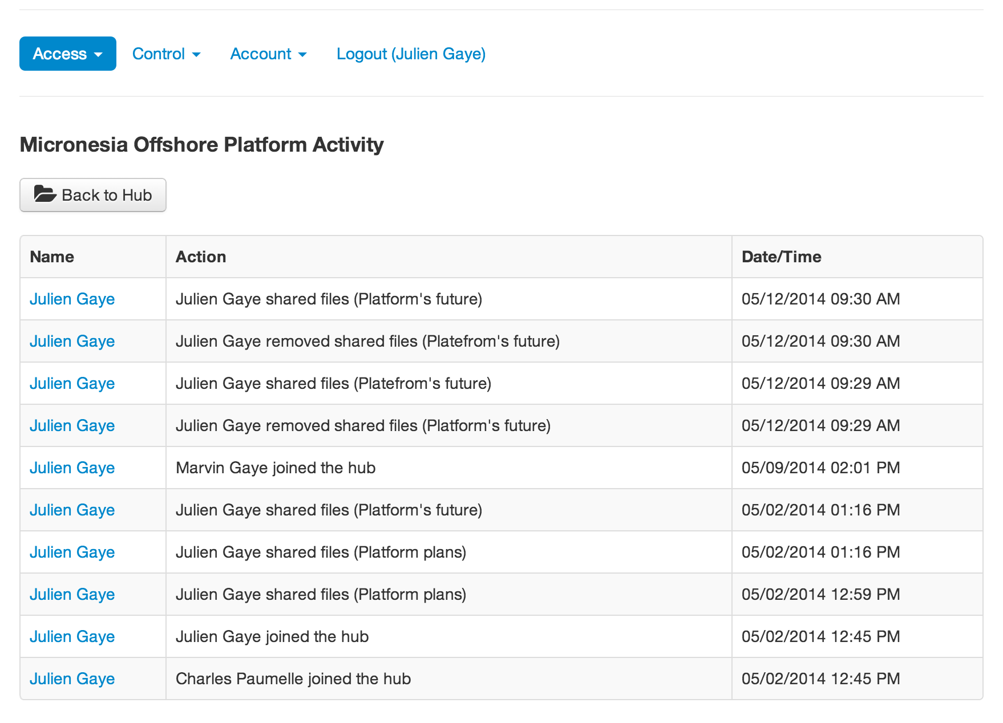
Hub activity
Notes:
The Storage Admin

